Slide 1
Big Mountain Ski Resort
Problem: How can Big Mountain increase ticket cost or decrease operating cost to select a better value for their ticket price and capitalize on its assets?
Contents by Page:
2. Problem identification
3. Recommendation
4. Findings to support Recommendation
5. Models and Analysis to support Findings
6. Summary

Slide 2
Problem Identification
Can we implement a more data driven business strategy?
Need better ticket pricing
Ticket price based solely off premium of average ticket price
Big Mountain does not capitalize on facilities and features
Although premium ticket price, could still be undervaluing ticket cost
What data can we provide to support ticket cost?
What data can be found and applied to support the cause?

Slide 3
Recommendations and Key Findings
With the data given, this is what our models suggested:
Big Mountain is undervaluing their ticket price by close to $15
Vertical drop, # of runs, # of chairs, snow making, and fast quads are the biggest positives when it comes to facilities (Big Mountain excels at these)
In the scenario suggested, I believe it will have a big impact on decision making (next slide)

Slide 4
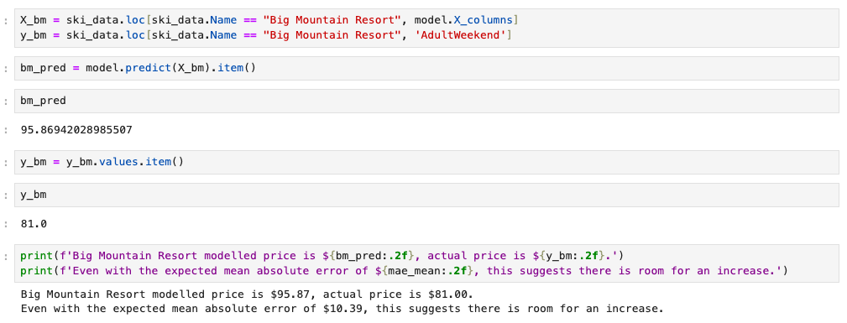
Model and Analysis Support
To explain on the right, we used our model to predict the ticket price based on the features of Big Mountain and came to the suggestion that Big Mountain is actually undervaluing their tickets but close to $15. Although there is a margin for error for close to $10, this still suggests there is room for an increase in ticket price.

Slide 5
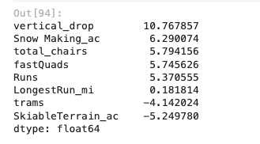
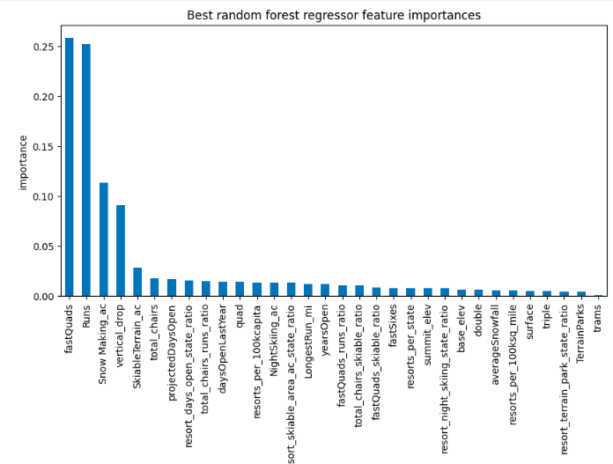
Model and Analysis Support
Secondly, on two separate models it shows identical features that have the most impact and percentage of importance.
Vertical Drop, Snow making, # of chairs, # of runs and fast quads are amongst the most impactful.
The next slide will provide diagrams that support Big Mountain ranks highly in these categories.
(Red line depicts Big Mountain)

Slide 6
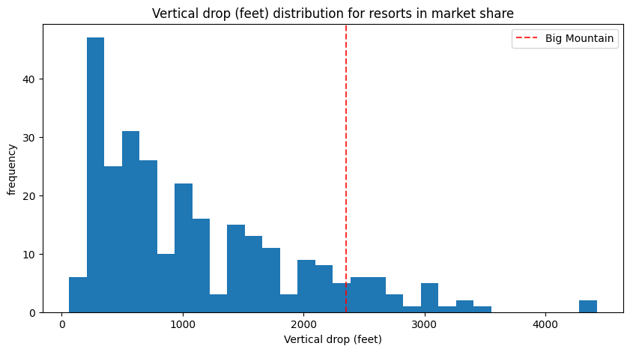
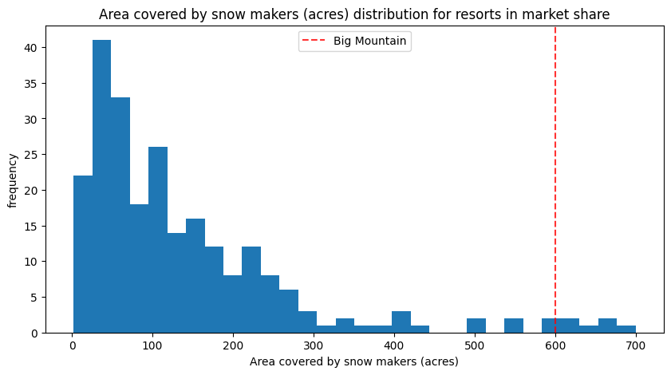
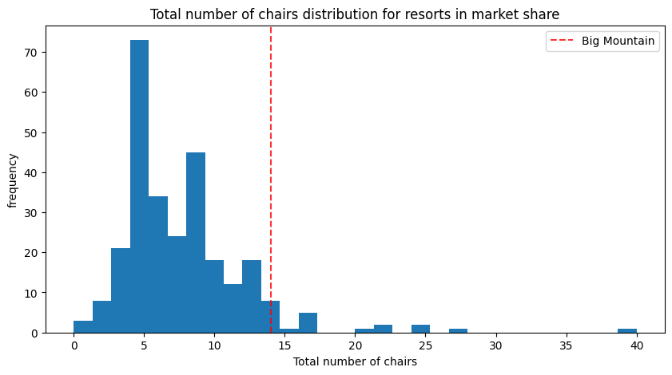
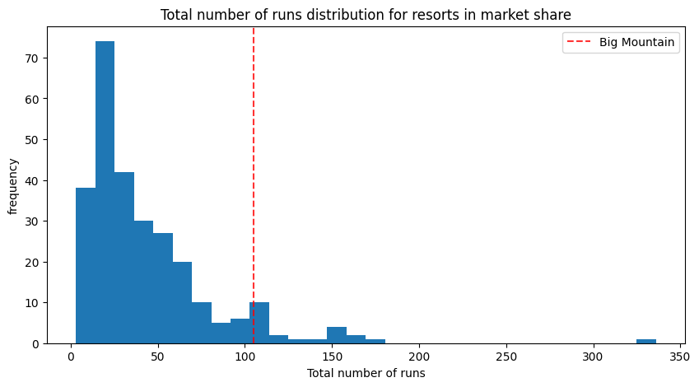

Slide 7
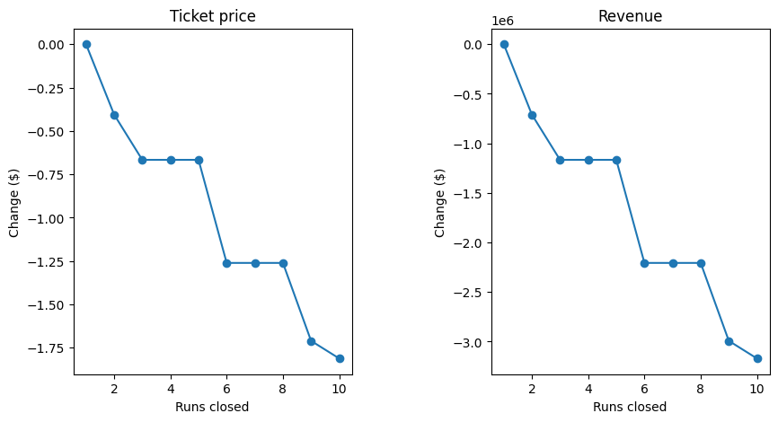
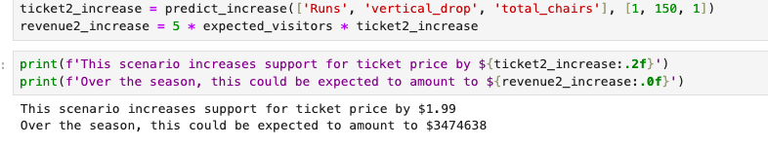
Model and Analysis Support
With the top diagram showcasing the loss of revenue/ticket price if we were to remove runs, the suggested scenario can improve revenue and ticket price.
Scenario that can increase ticket price and revenue:
↑ runs by 1
↑ vertical drop by 150
↑ increase # of chairs
Our model suggests doing this supports an increase of ticket price by $2, totalling an increased revenue seasonally by $3.47 million.

Slide 8
Summary
Blue Mountain has all the most impactful features when it comes down to facilities amongst its league of resorts.
With the collected data, we can be confident in increasing ticket prices without backlash of overpricing.
A next step could be lessen/remove facilities that negatively impact ticket cost, which can help cut operation costs while keeping the ticket price up.

